Slide 1
CSE110
Programming Language I

Slide 2
My Brief Profile
Nahian Salsabil (NNS)
Lecturer, CSE, BRACU
BSc: CSE, BUET, 2023
Email: Email: nahian.salsabil@bracu.ac.bd
Room No. UB80601
Consultation Hour:
Sunday: 11:00am - 1:30pm
Monday: 9:30am - 10:50am, 12:30pm - 1:30pm
Wednesday: 9:30am - 10:50am

Slide 3
Links
Resources: http://tiny.cc/cse110_resources_NNS
Slack: http://tiny.cc/cse110_slack

Slide 4
Topics Covered so far
Variables
Operators
Data Type, Type Conversion
Input()
Print()
Branching

Slide 5
Outline
Loop
While
For

Slide 6
Iteration (Loops)

Slide 7
Problem
Print “I love Bangladesh” five times

Slide 8
Problem
Print “I love Bangladesh” five times
Print “I love Bangladesh” ten times

Slide 9
Problem
Print “I love Bangladesh” five times
Print “I love Bangladesh” ten times
Print “I love Bangladesh” thousand times

Slide 10
Problem
Print “I love Bangladesh” five times
Print “I love Bangladesh” ten times
Print “I love Bangladesh” thousand times
Not possible to do it manually. Need to use iterations!

Slide 11
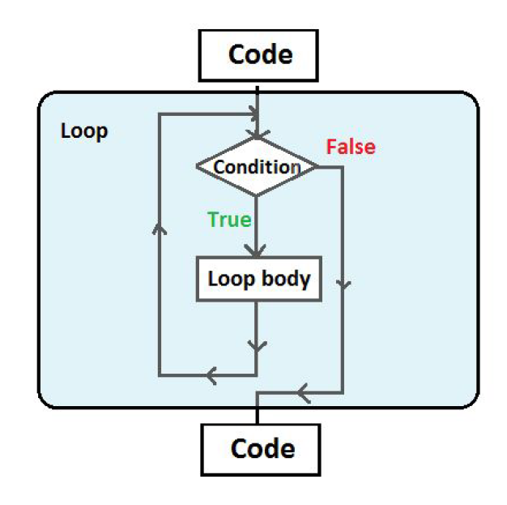
Iterations
Two types of looping constructs:
While
For

Slide 12
while loop
If the condition is true, the statement is executed.
Then the condition is evaluated again, and if it is still true, the statement is executed again.
The statement is executed repeatedly until the condition becomes false.
while condition:
statement

Slide 13
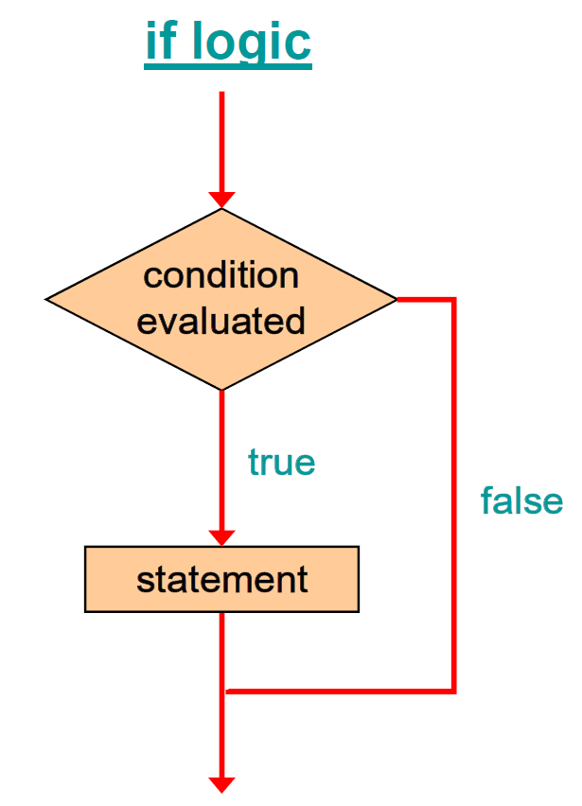
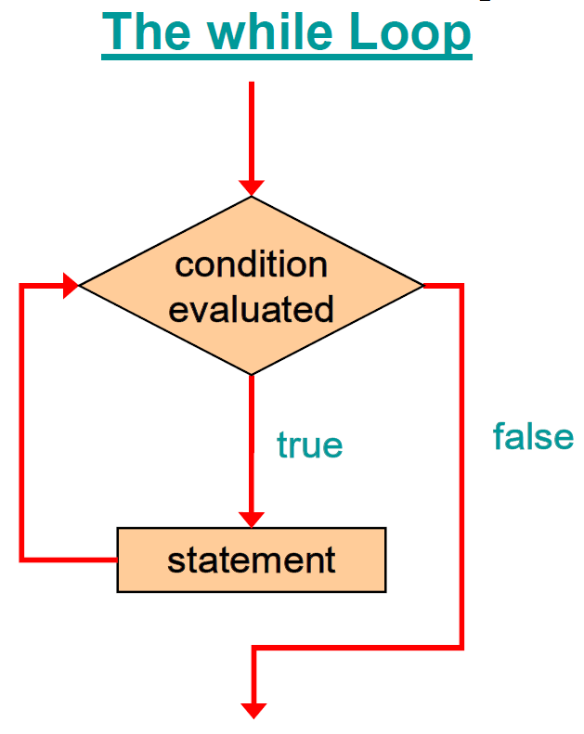
Logic of a while loop

Slide 14
Components of while loop
Initialization
Condition
Statement
Update count variable
count = 1
while count <= 5:
print(“Hello world!”)
count += 1

Slide 15
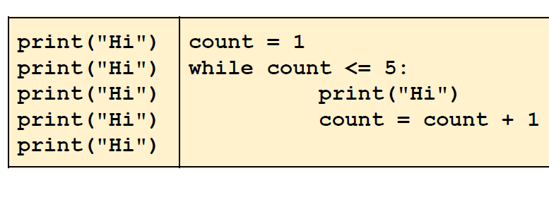
While looping

Slide 16
Print the first n integers
n = int(input())
count = 1
while count <= n:
print(count)
count += 1

Slide 17
Print the even numbers up to n
n = int(input())
count = 1
while count <= n:
if count % 2 == 0:
print(count)
count += 1

Slide 18
Print the sum of first n integers
n = int(input())
count = 1
sum = 0
while count <= n:
sum += count
count += 1
print(sum)

Slide 19
print the sum of all the odd integers from 0 to N
num = 0
odd_sum = 0
while num <= 100:
if num % 2 != 0:
odd_sum += num
num += 1
print("Sum of odd integers from 0 to 100:", odd_sum)

Slide 20
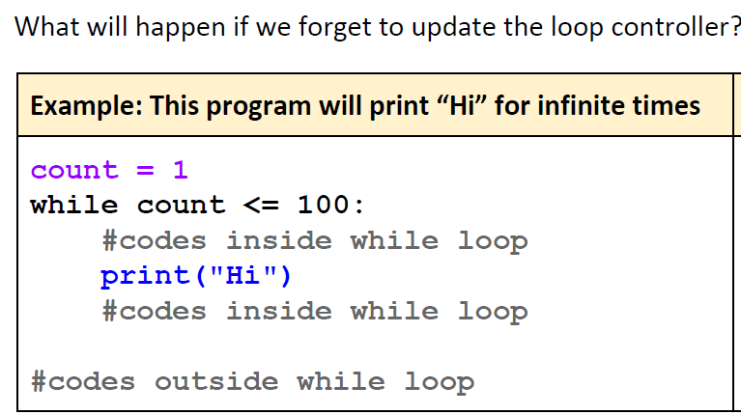

Slide 21
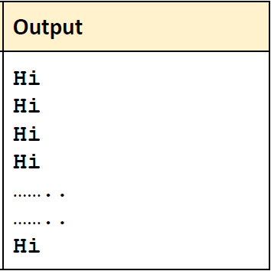
Infinite Loops
Here the program will never terminate and it will print “Hi” for an infinite number of times (until the memory runs out). It is called “ Infinite loops ”.

Slide 22
Solution
Never forget to update the loop controller !

Slide 23
Break
Breaking the loop means getting out of the loop.
A loop breaks when the condition becomes false
This loop will break when count <=5 becomes false, ie count>5

Slide 24
break statement
Another way of getting out of the loop (ie breaking the loop)
Can terminate the current iteration or even the whole loop without checking the “loop terminating condition”.

Slide 25
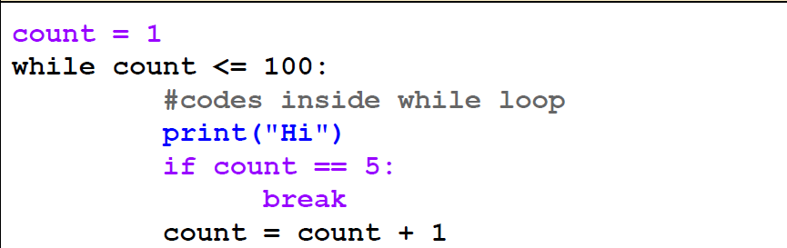
What is the output ?

Slide 26

What is the output ?

Slide 27
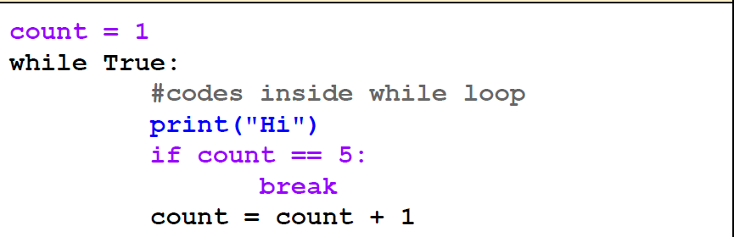
What is the output ?

Slide 28
What is the output ?

Slide 29
Problem
Write a program to find the first element between 100 and 200 which is divisible by 13 but not by 3.

Slide 30
Solution
Write a program to find the first element between 100 and 200 which is divisible by 13 but not by 3.
num = 100
while num <= 200:
if num % 13 == 0 and num % 3 != 0:
print("First element between 100 and 200 divisible by 13 but not by 3:", num)
break
num += 1

Slide 31
Continue statement
Unlike “break”, “continue” does not terminate the current loop; instead, it skips the rest of the codes of the current iteration and moves on to the next iteration.

Slide 32
Continue statement
count = 1
while count <= 5:
print("=====")
print("Hi")
count = count + 1
if count == 3:
continue
print("Bye")
print("=====")
What is the output?

Slide 33
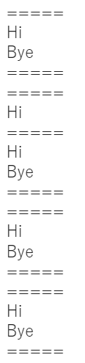
Continue statement
count = 1
while count <= 5:
print("=====")
print("Hi")
count = count + 1
if count == 3:
continue
print("Bye")
print("=====")
Output

Slide 34
Continue statement
count = 1
while count <= 5:
print("=====")
print("Hi")
if count == 3:
continue
print("Bye")
print("=====")
count = count + 1
What is the output?

Slide 35
Continue statement
count = 1
while count <= 5:
print("=====")
print("Hi")
if count == 3:
continue
print("Bye")
print("=====")
count = count + 1
During the 3rd iteration, the update of the loop controller, “counter” has been skipped by
continue. So after the 3rd iteration, it prints “Hi” for an infinite time.
Can you solve that infinite loop problem?

Slide 36
Problem
Write a python program that iterates from 0 to 100 and prints all the numbers except for those that are divisible by 5.

Slide 37
Solution
Write a python program that iterates from 0 to 100 and prints all the numbers except for those that are divisible by 5.
num = 0
while num <= 100:
if num % 5 == 0:
num += 1
continue
print(num)
num += 1

Slide 38
List revisited
x = [1, 2, 3, 4]
y = [1, 2.0, [3, 4]]
y = [1.0, -2, “Hello!”, [“World”, 2]]

Slide 39
for loop
During every iteration, iterator will contain the next element in the list.
iterator is a Python variable.
for loop can iterate through a list.
The iterating variable or loop iterator goes through all the elements of the list sequentially from left to right.
for is a Python keyword
for iterator in list:
statement
statement will execute once for every element in the list

Slide 40
for loop
marvel_heroes = ["Black Panther", "Captain America", "Iron Man", "Ant-Man"]
for hero in marvel_heroes:
print(hero)
print(“Good bye!”)
Output:
Black Panther
Captain America
Iron Man
Ant-Man
Good bye!

Slide 41
for loop
Output:
T
o
n
y
S
t
a
r
k
Good bye!
iron_man = “Tony Stark”
for char_iter in iron_man:
print(char_iter )
print(“Good bye!”)

Slide 42
Exercise
Given a list of integers, print the sum of all the numbers in that list.
num_list = [1, 2, 3, 4, 5]
sum = 0
for num in num_list:
sum += num
print("The sum is", sum)

Slide 43
Python range() function
The range() function returns a sequence of numbers, in a given range.
The most common use of it is to iterate sequences on a sequence of numbers using Python loops.
range(start, stop, step)
start | (Optional) An integer number specifying at which position to start. Default is 0
stop | Required. An integer number specifying at which position to stop (not included).
step | (Optional) An integer number specifying the incrementation. Default is 1.

Slide 44
Python range() function
range(start(Optional), stop, step(Optional))
start
step
x = range(1, 5, 1)
Sequence: 1, 2, 3, 4
x = range(1, 9, 2)
Sequence: 1, 3, 5, 7
stop/end
Only stop or end
start
stop/end
x = range(5)
Sequence: 0, 1, 2, 3, 4
x = range(3, 7)
Sequence: 3, 4, 5, 6

Slide 45
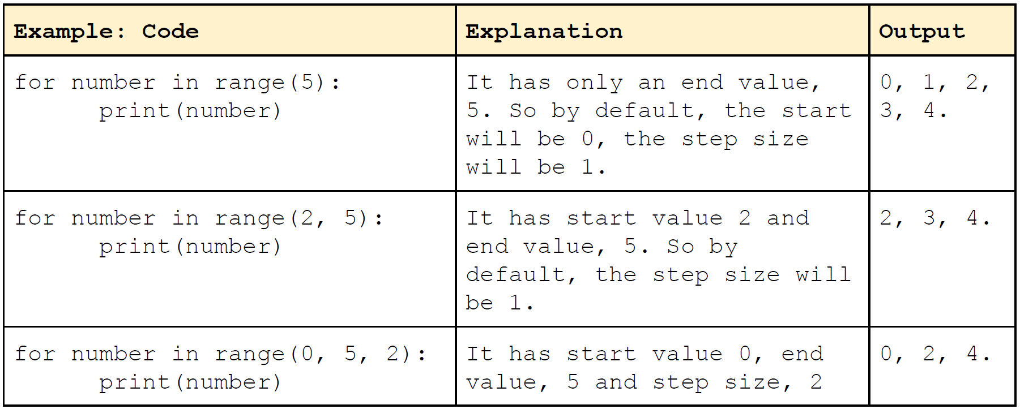
Using range() function in for loop

Slide 46
Exercise
Print “I love Python!” 100 times.
count = 1
while count <= 100:
print(“I love Python!”)
count += 1
for i in range(100):
print(“I love Python!”)

Slide 47
Exercise
Print the first n integers.
n = int(input(‘Enter an integer=‘))
for i in range(1, n+1):
print(i)
n = int(input(‘Enter an integer=‘))
count = 1
while count <= n:
print(count)
count += 1
n = int(input(‘Enter an integer=‘))
for i in range(n):
print(i+1)

